Slide 1
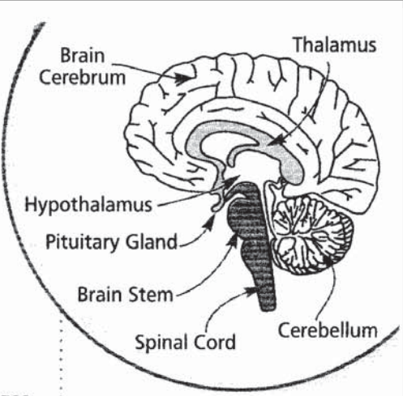

Slide 2
The Nervous System
Aim: to speak about the nervous system
Tasks :
To listen to the text about nervous system
To learn the parts of the nervous system.
To make up a quiz about the nervous system.

